Slide 1


DevOps
with GitHub and Azure

Slide 2
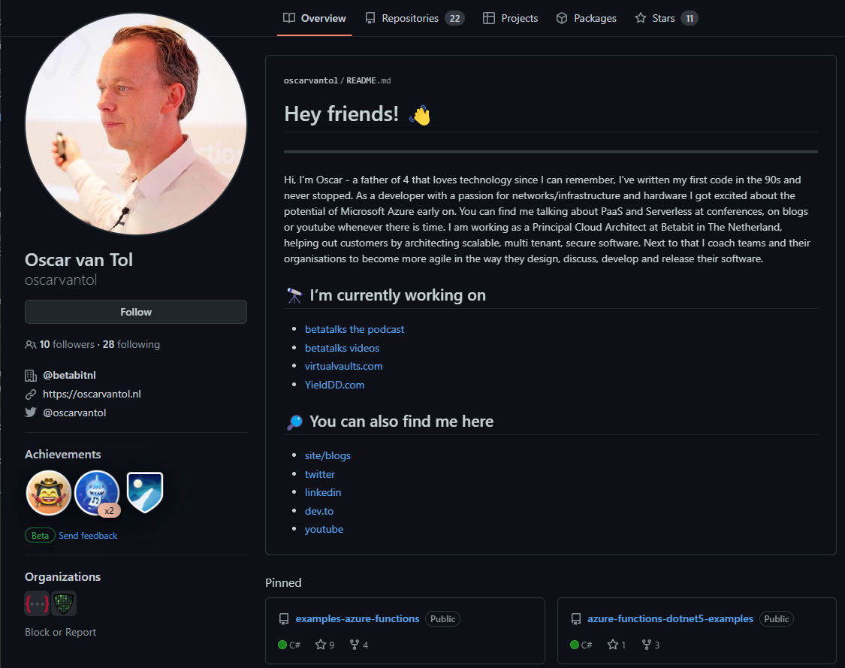
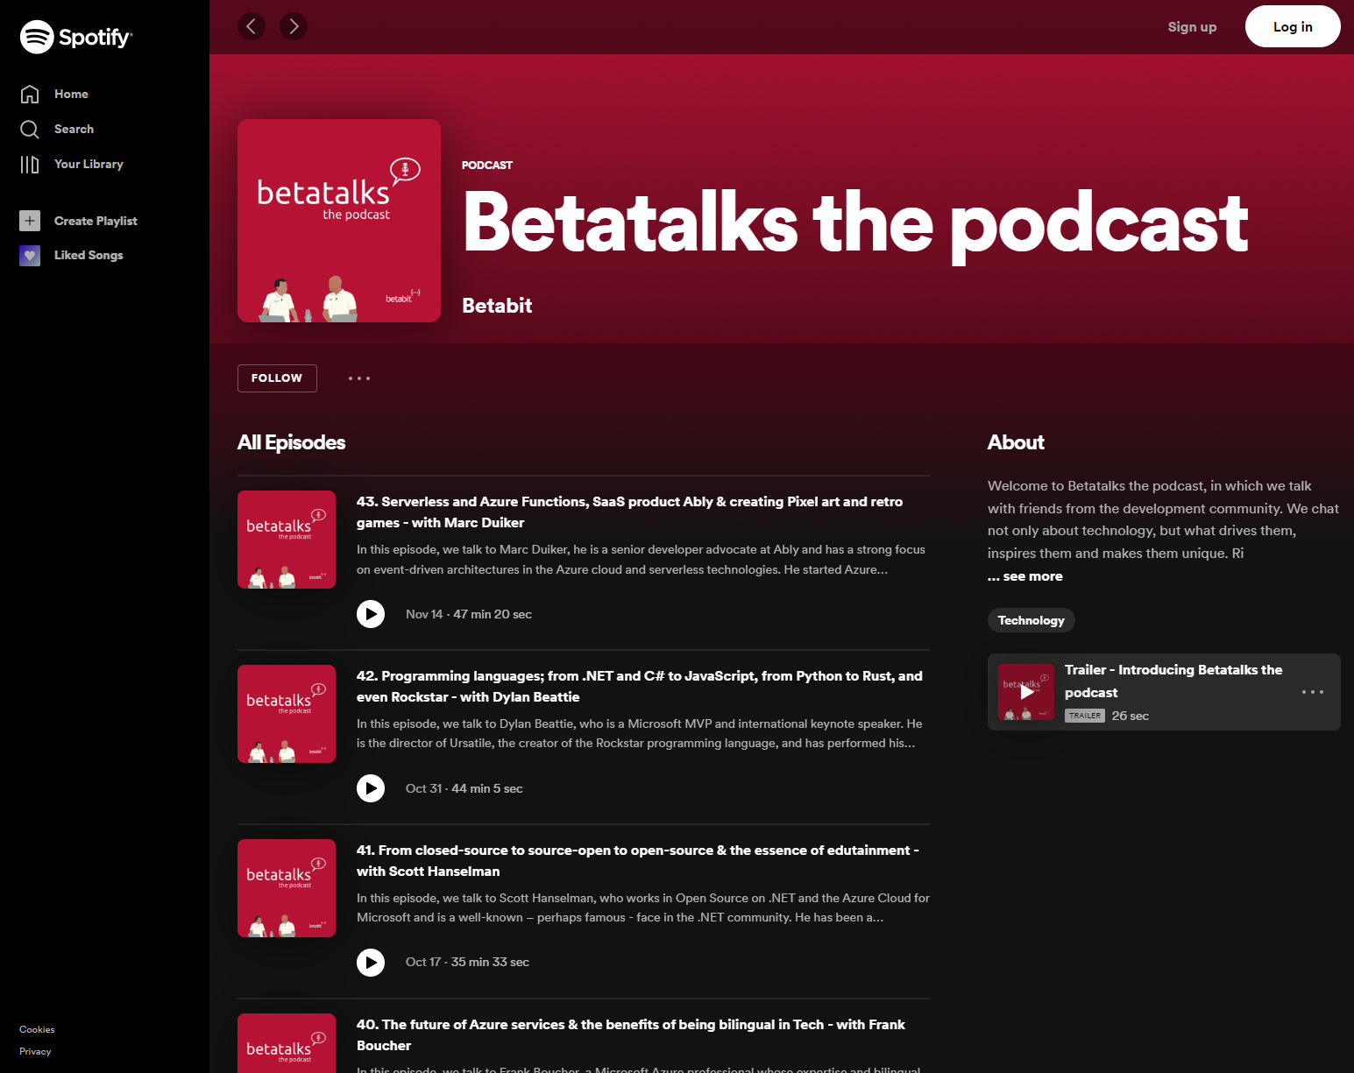
github.com/oscarvantol
podcast.betatalks.nl
https://linktr.ee/oscarvantol

Slide 3
Agenda
Introduction
The core of GitHub
Project management
Automation
Infrastructure as Code
Package Management
Remote development
Code scanning
Pricing and features
Closing

Slide 4
Introduction
Some terminology

Slide 5
DevOps
The contraction of "Dev" and "Ops" refers to replacing siloed Development and Operations. The idea is to create multidisciplinary teams that now work together with shared and efficient practices and tools.
Essential DevOps practices include:
agile planning
continuous integration
continuous delivery
monitoring of applications
DevOps is the union of people, process, and products to enable continuous delivery of value to your end users.
— Donovan Brown

Slide 6
Inner Source
Inner source is the use of open source software development best practices and the establishment of an open source-like culture within organizations for the development of its non-open-source and/or proprietary software.

Slide 7
GitOps
GitOps is a way of implementing Continuous Deployment for cloud native applications. It focuses on a developer-centric experience when operating infrastructure, by using tools developers are already familiar with, including Git and Continuous Deployment tools.
The core idea of GitOps is having a Git repository that always contains declarative descriptions of the infrastructure currently desired in the production environment and an automated process to make the production environment match the described state in the repository.

Slide 8
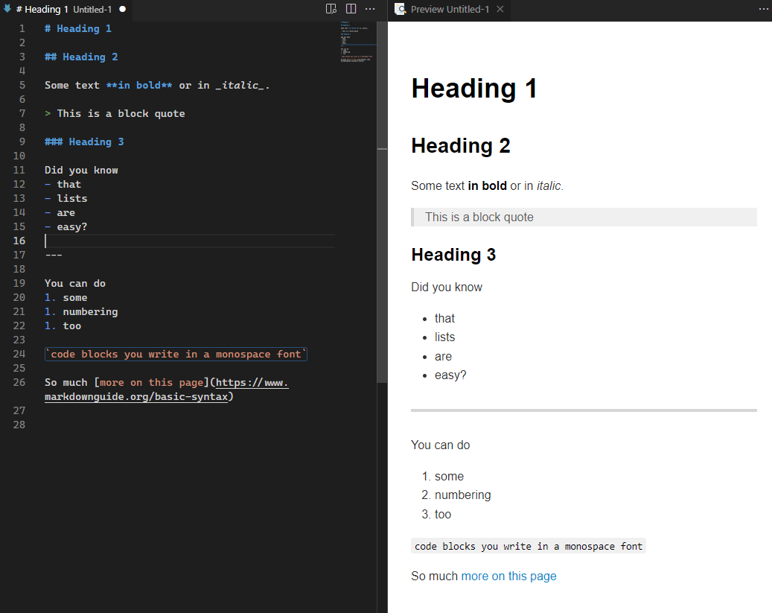
Markdown
Markdown is a lightweight markup language for creating formatted text using a plain-text editor.
John Gruber and Aaron Swartz created Markdown in 2004 as a markup language that is appealing to human readers in its source code form.

Slide 9

The core of GitHub
repositories

Slide 10
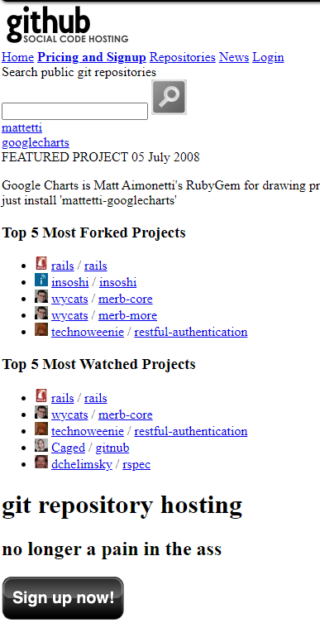
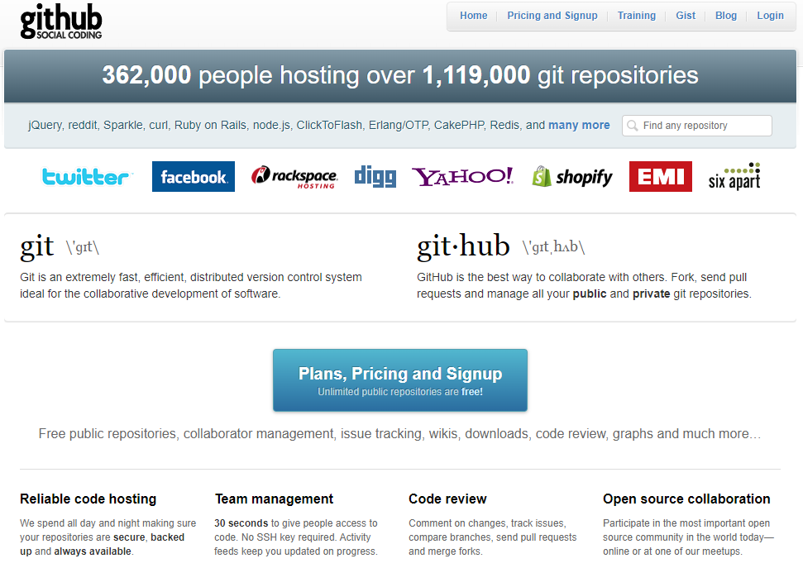
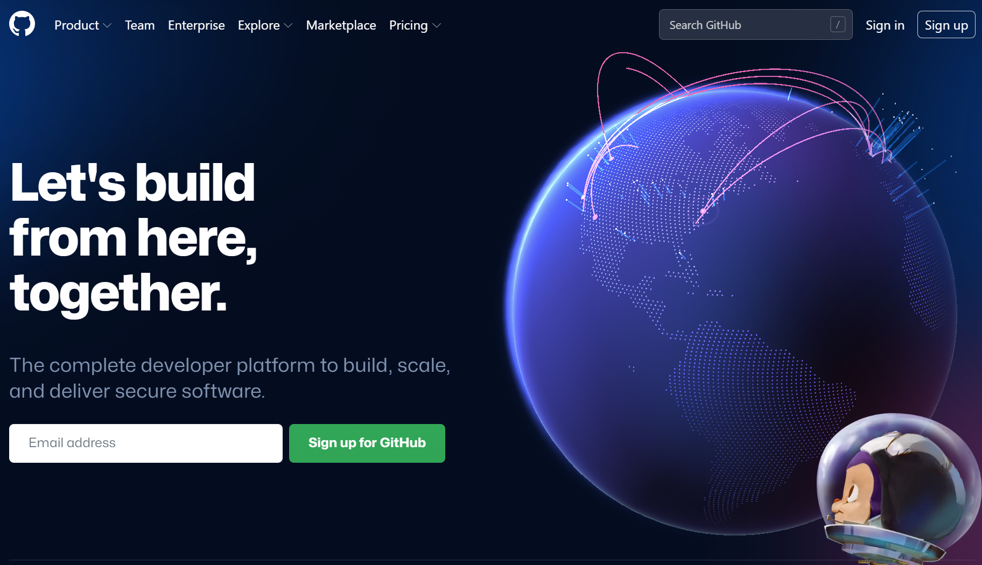
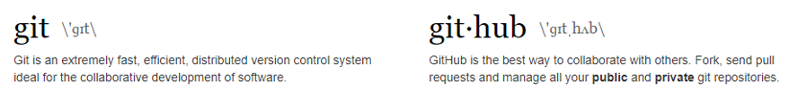
GitHub
Notes:
GitHub 2008
CodePlex 2006
Google Code 2005
SourceForge 1999

Slide 11
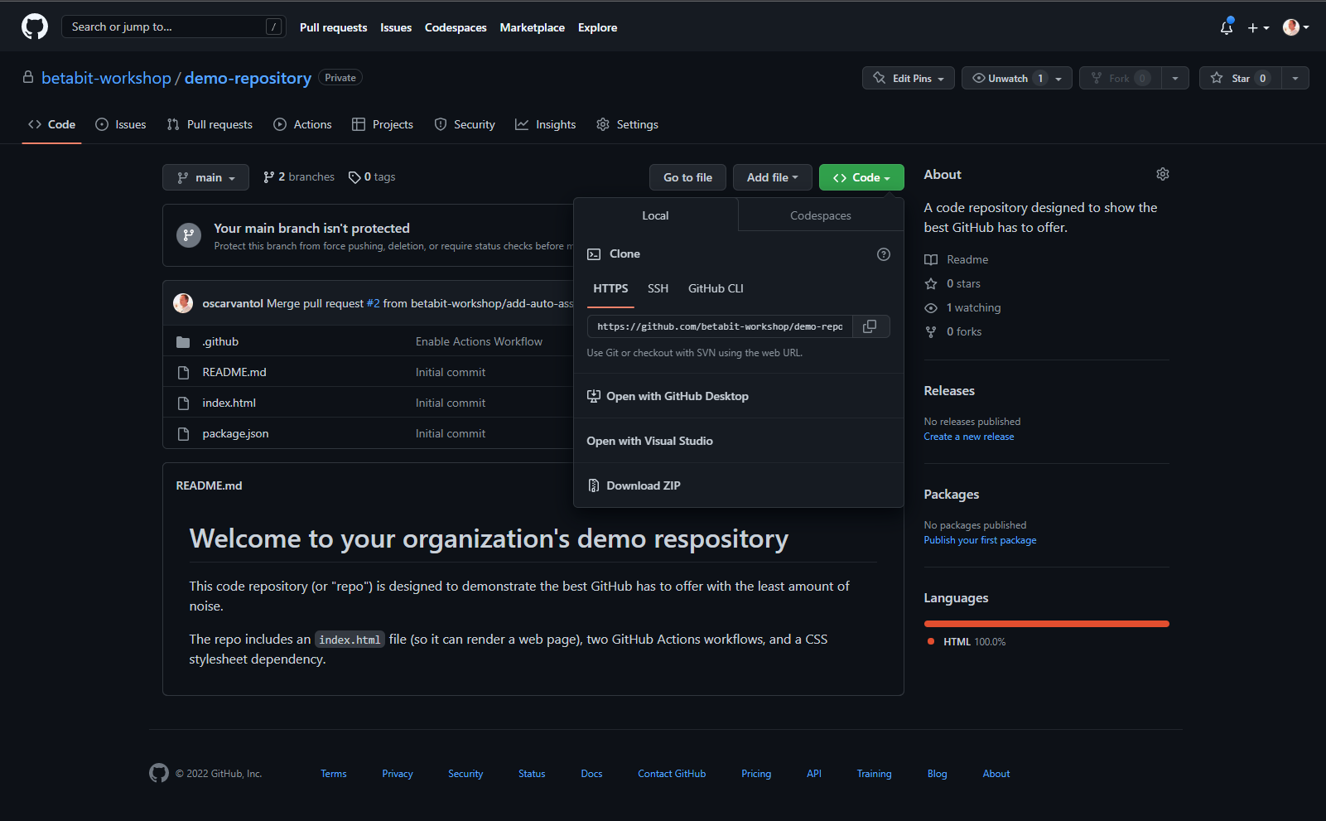
Repositories

Slide 12
Git(Hub) terminology
Commit
Branch / Merge
Pull Request
Fork
Fetch upstream / sync fork

Slide 13
Branch protection
You can protect important branches by setting branch protection rules, which define whether collaborators can delete or force push to the branch and set requirements for any pushes to the branch, such as passing status checks or a linear commit history.
Require PR
Require pass status checks
Require conversation resolution
Require signed commits
Require linear history
Require successful deployment
Lock branch
Prevent bypassing

Slide 14
Lab
Create an account
Join an organization
https://github.com/betabit-workshop
Create a branch
https://github.com/betabit-workshop/core-api
Add yourself to the README.md
Complete a Pull Request
Notes:
Repo: Core-api
Add yourself to the readme

Slide 15

Project management
Collaboration

Slide 16
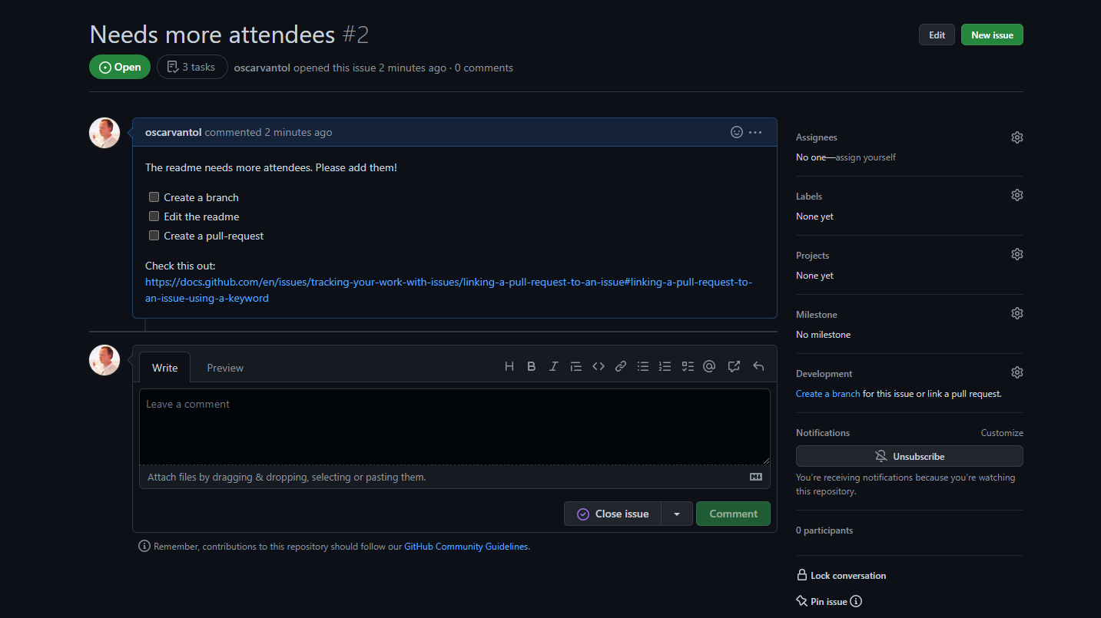
Issues
Issues let you track your work on GitHub, where development happens. When you mention an issue in another issue or pull request, the issue's timeline reflects the cross-reference so that you can keep track of related work.
Notes:
To indicate that work is in progress, you can link an issue to a pull request. When the pull request merges, the linked issue automatically closes.

Slide 17
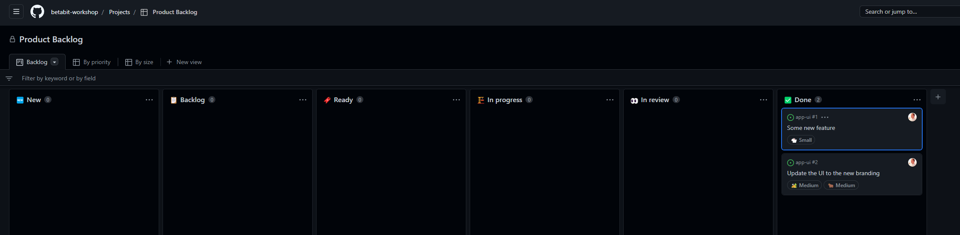
Projects
A project is an adaptable spreadsheet that integrates with your issues and pull requests on GitHub to help you plan and track your work effectively.
Notes:
You can create and customize multiple views by filtering, sorting, grouping your issues and pull requests, adding custom fields to track metadata specific to your team, and visualize work with configurable charts. Rather than enforcing a specific methodology, a project provides flexible features you can customize to your team’s needs and processes.
https://github.com/orgs/betabit-workshop/projects

Slide 18
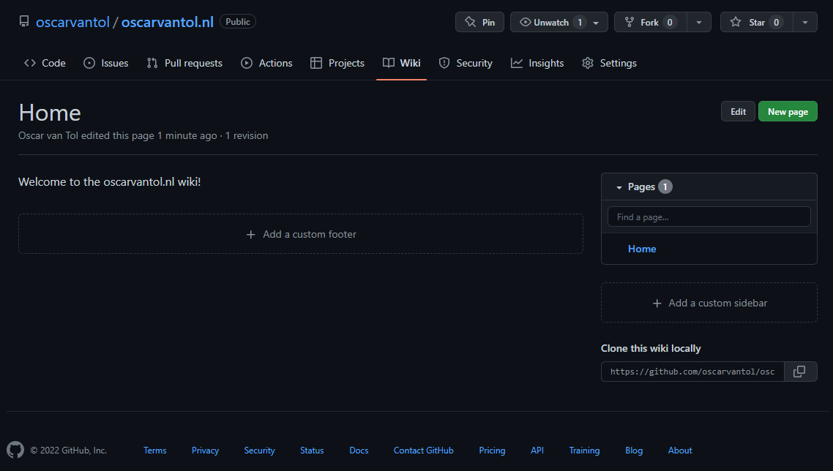
Wiki

Slide 19
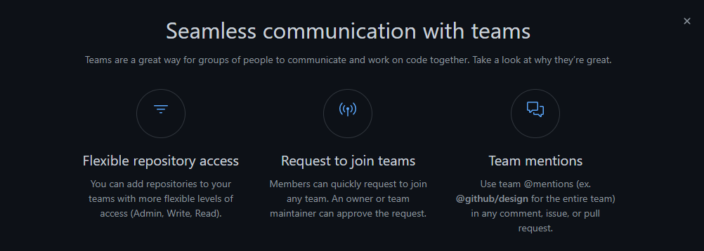
Teams
Notes:
https://github.com/orgs/betabit-workshop/teams

Slide 20
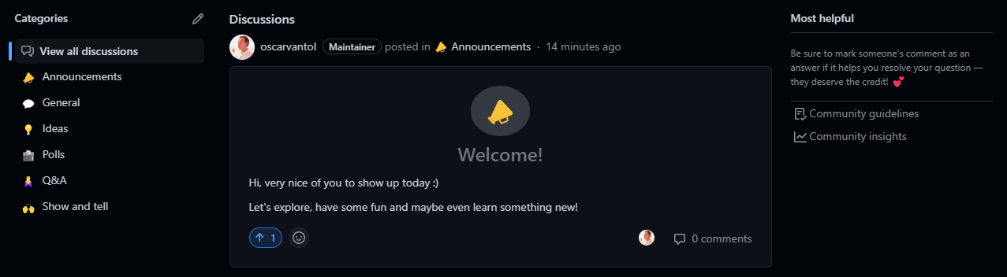
Discussions
GitHub Discussions is a collaborative communication forum for the community around an open source or internal project. Discussions are for conversations that need to be transparent and accessible but do not need to be tracked on a project board and are not related to code, unlike GitHub Issues. Discussions enable fluid, open conversation in a public forum.
Notes:
Discussions give a space for more collaborative conversations by connecting and giving a more centralized area to connect and find information.
https://github.com/betabit-workshop/betabit-workshop/discussions

Slide 21
Lab
Pick any these tasks:
Create an issue
Bonus: reference a pr that auto-closes the issue
Plan a feature on the project board
Create a wiki page
Bonus: use mermaid to create a diagram
Start a discussion
(on GitHub discussions)
Notes:
https://docs.github.com/en/issues/tracking-your-work-with-issues/linking-a-pull-request-to-an-issue
https://gist.github.com/martinwoodward/8ad6296118c975510766d80310db71fd

Slide 22

Automation
Using GitHub Actions

Slide 23
GitHub Actions
Automate, customize, and execute your software development workflows right in your repository with GitHub Actions. You can discover, create, and share actions to perform any job you'd like, including CI/CD, and combine actions in a completely customized workflow.
Versioned code(YAML) inside the repo
Runners (GitHub hosted or self hosted)
Custom Actions and Marketplace
Secrets
Environments

Slide 24
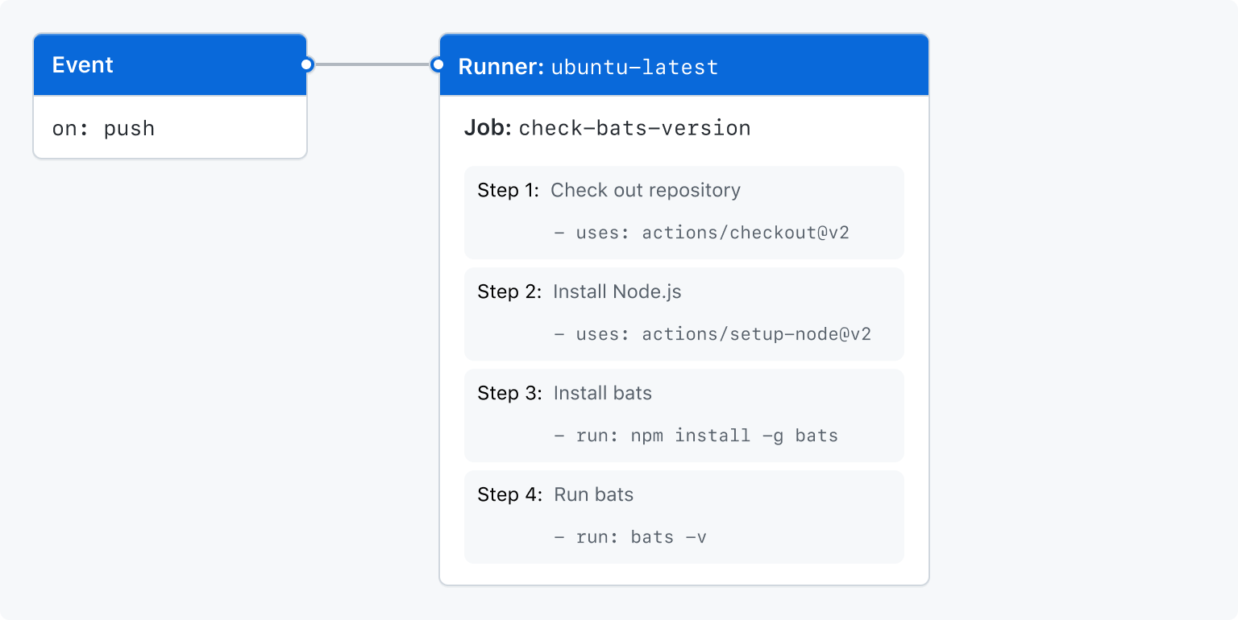
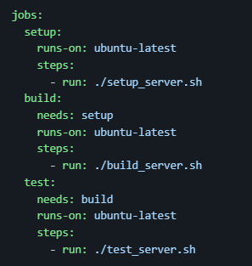
Lab
Build a “Hello World” pipeline using GitHub actions
https://docs.github.com/en/actions/using-workflows/about-workflows

Slide 25
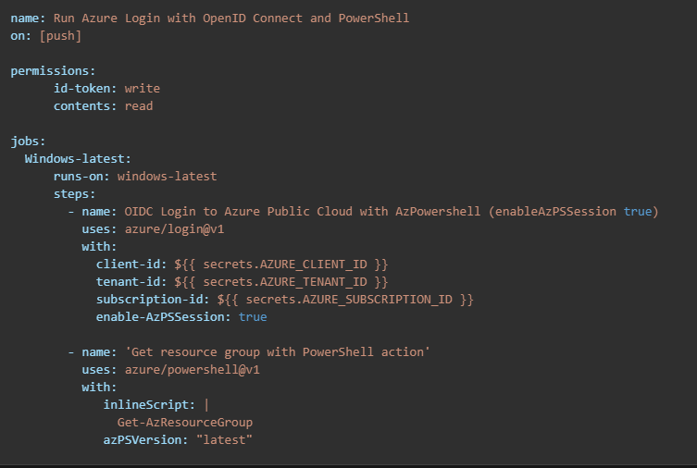
Demo
Connecting to Azure using OIDC
Create an Azure Active Directory application and service principal
Add federated credentials
Create GitHub secrets
Set up Azure Login with OpenID Connect authentication
Notes:
https://docs.github.com/en/actions/deployment/security-hardening-your-deployments/configuring-openid-connect-in-azure
https://learn.microsoft.com/en-us/azure/developer/github/connect-from-azure?tabs=azure-portal%2Cwindows
Use the Azure login action with a service principal secret
Use the Azure login action with OpenID Connect
https://github.com/oscarvantol/azure-oidc

Slide 26
Infrastructure as Code
With Bicep

Slide 27
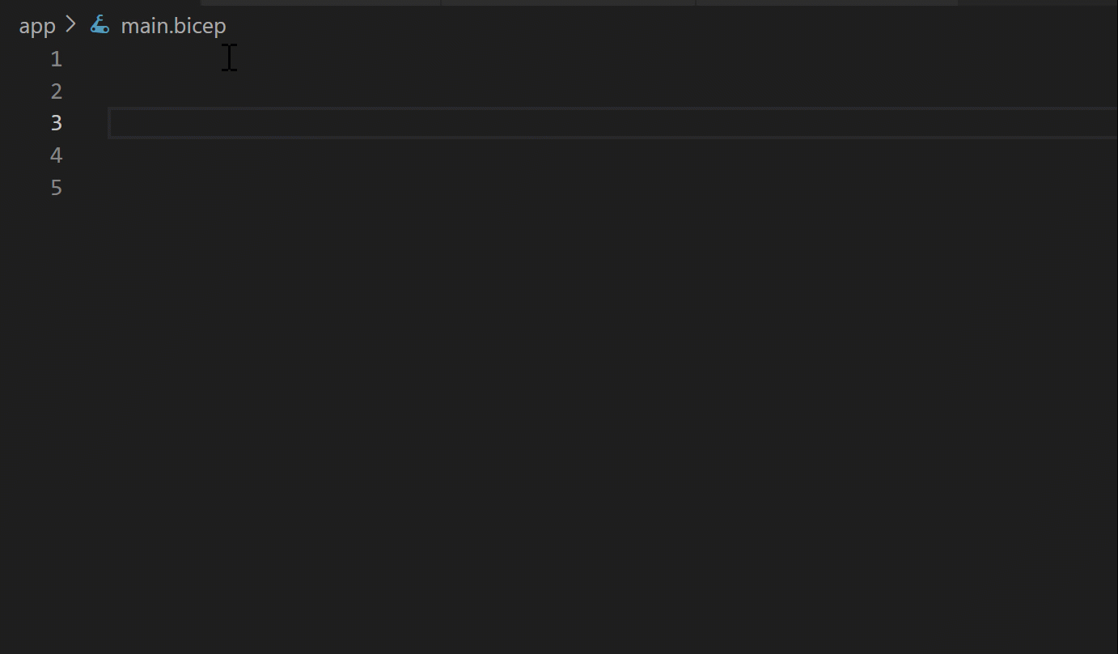
Bicep
Domain Specific Language
Declarative Syntax
Type safety
Immediate api support

Slide 28
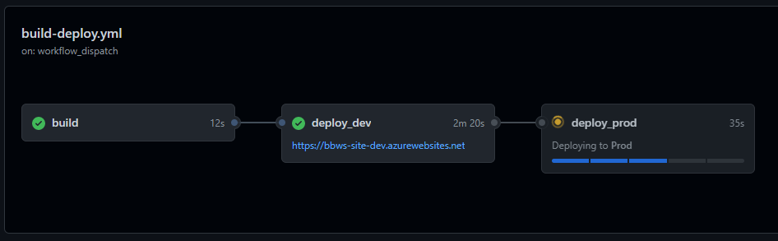
Lab
Create an Azure Webapp infrastructure using Bicep
Build and package the app
Provision the infrastructure
Deploy to Azure using a gated environment
https://github.com/betabit-workshop/envs
Notes:
AZ CLI, vscode

Slide 29

Remote development
Codespaces

Slide 30
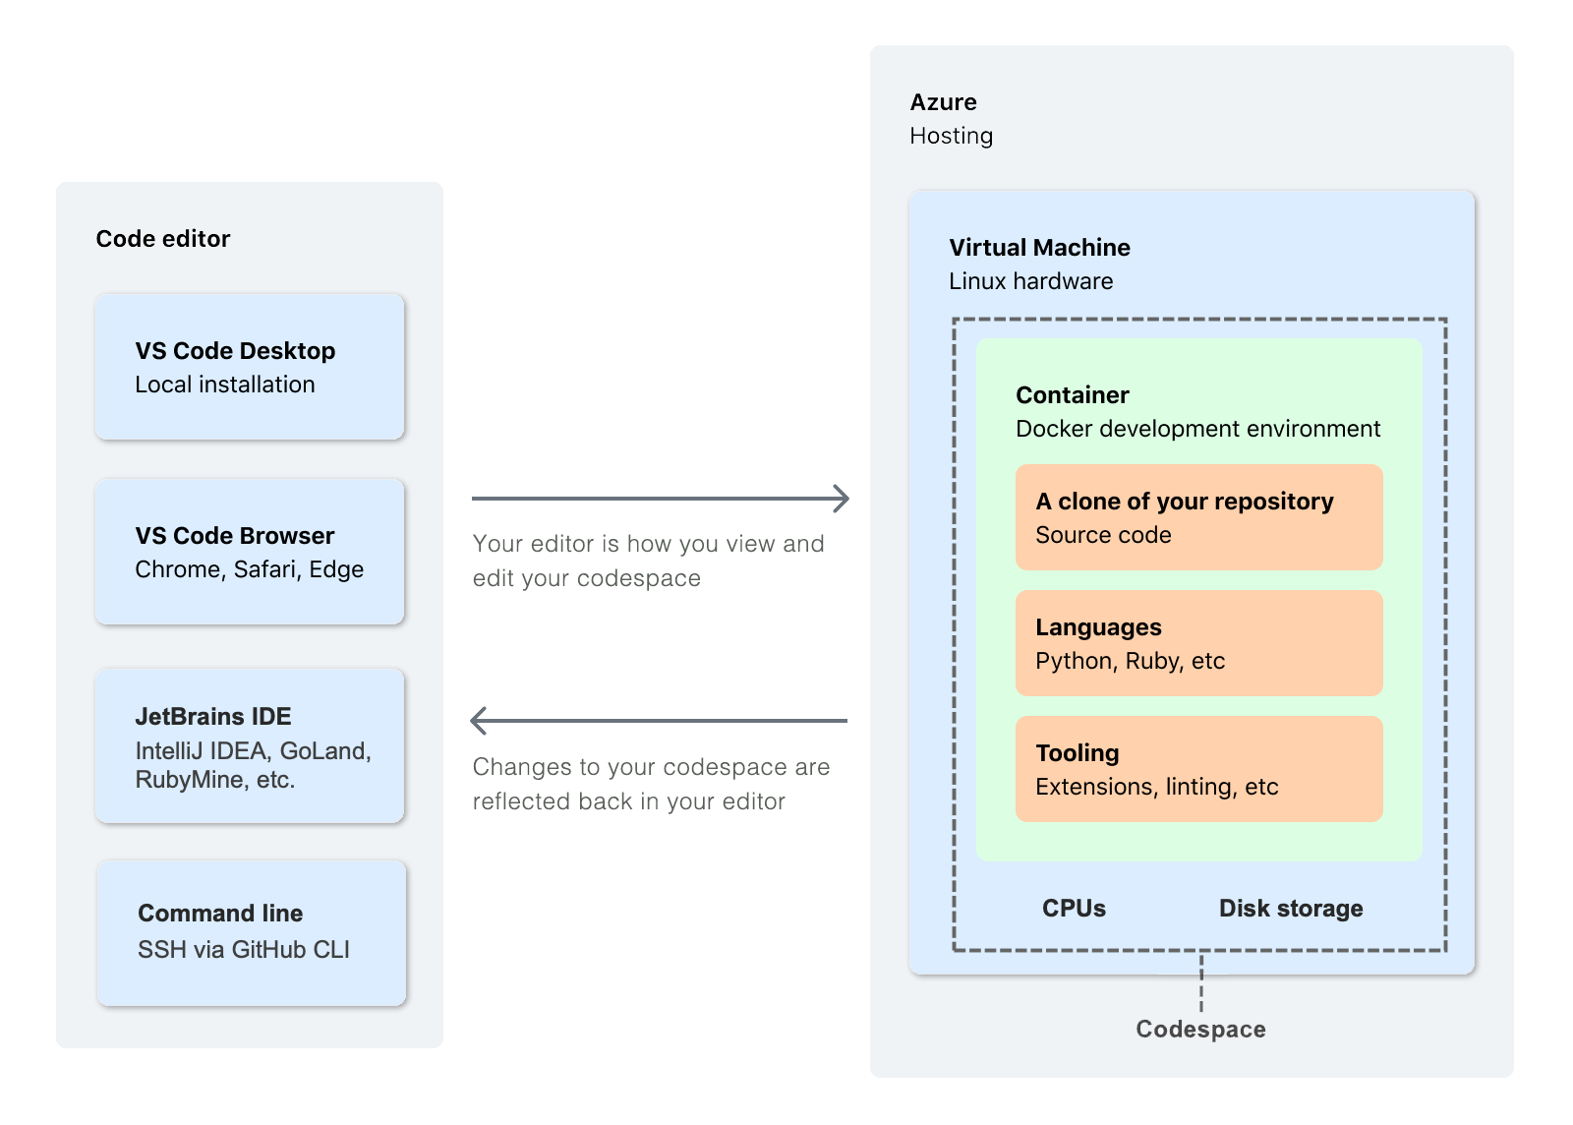
Code spaces

Slide 31
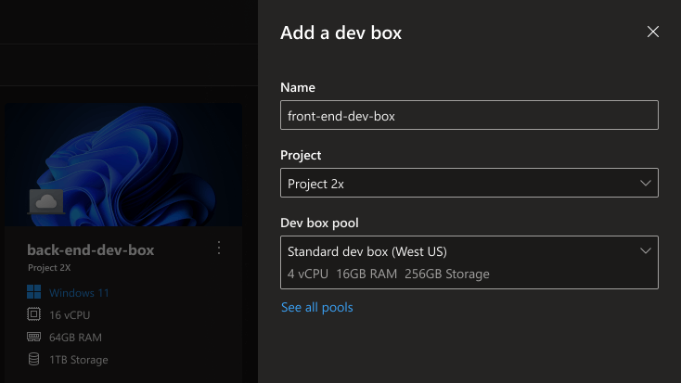
Azure Dev Box
https://azure.microsoft.com/products/dev-box/

Slide 32

Package management

Slide 33
Lab
Use a package
https://github.com/orgs/betabit-workshop/packages
Push a package
Notes:
https://github.com/betabit-workshop/example-package
echo --- create a new project
dotnet new classlib --name SomeExample
cd SomeExample
echo --- building and packing the lib
dotnet pack --configuration Release --version-suffix ${{github.run_number}} /p:RepositoryUrl=https://github.com/betabit-workshop/example-package
pkgname=$(dir bin/**/*.nupkg)
echo --- create a nuget.config with a source
dotnet nuget add source --name github "https://nuget.pkg.github.com/betabit-workshop/index.json"
echo --- push package to source
dotnet nuget push $pkgname --api-key ${{ secrets.PACKAGEPAT }} --source "github"

Slide 34
Code scanning
https://docs.github.com/en/code-security
Notes:
https://docs.github.com/en/code-security

Slide 35
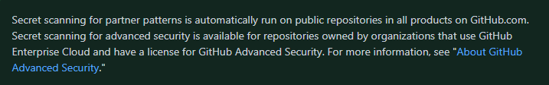
Secret scanning
GitHub scans repositories for known types of secrets, to prevent fraudulent use of secrets that were committed accidentally.
Notes:
https://docs.github.com/en/code-security/secret-scanning/about-secret-scanning

Slide 36
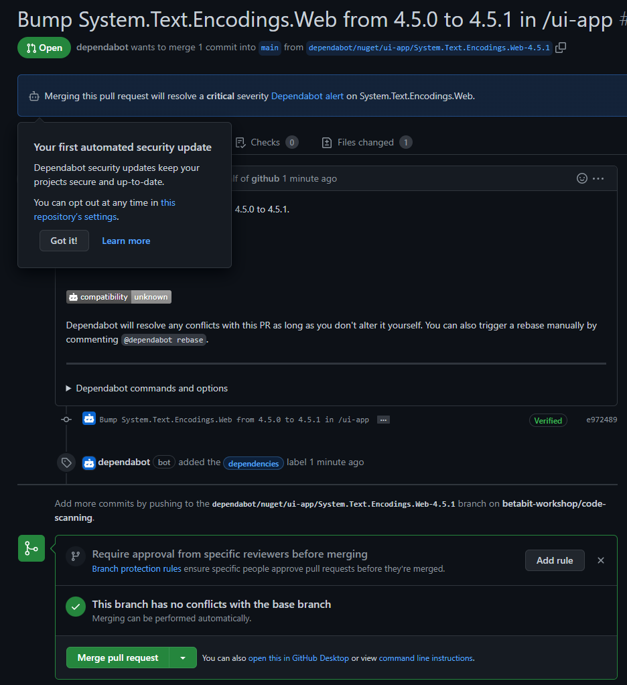
Dependabot
Monitor vulnerabilities in dependencies used in your project and keep your dependencies up-to-date with Dependabot.
Notes:
Vulerabillities
https://github.com/betabit-workshop/code-scanning
https://github.com/betabit-workshop/code-scanning/network/dependencies

Slide 37
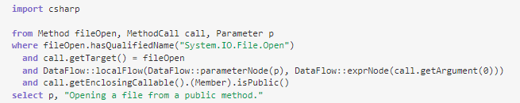
CodeQL
CodeQL is the analysis engine used by developers to automate security checks, and by security researchers to perform variant analysis.
VS Code: codeql.github.com/docs/codeql-for-visual-studio-code/
cli: codeql.github.com/docs/codeql-cli/
Notes:
https://codeql.github.com/docs/

Slide 38
Pricing and features

Slide 39
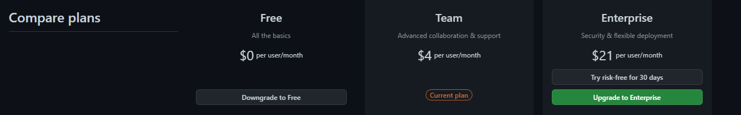
Plans
Notes:
https://github.com/organizations/betabit-workshop/billing/plans
https://github.com/pricing

Slide 40
Closing
Open discussion

